Slide 1
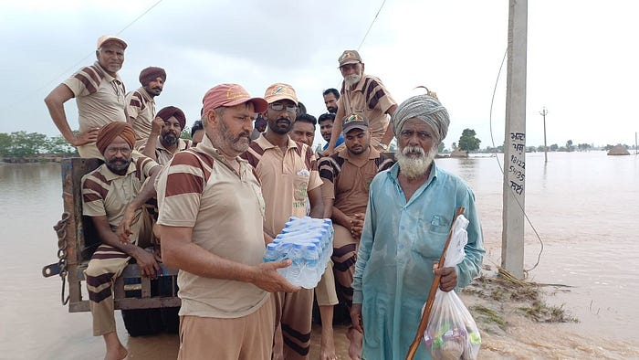
Record-Breaking Rainfall and Devastation: Floods Engulfing Haryana and Punjab as Green S Welfare Force Extends Relief Efforts

Slide 2
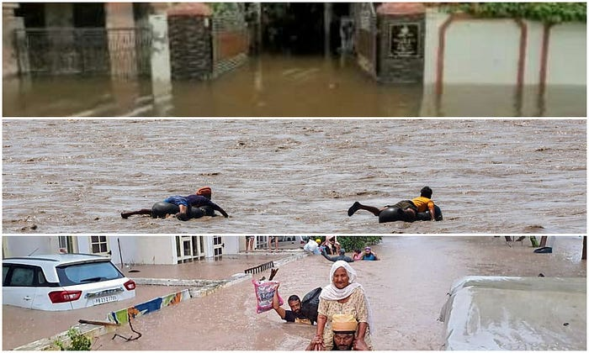
Haryana, Punjab and Himachal Pradesh the situation has gone bad in these states.

Slide 3
The heavy rainfall in the mountains has broken a record of the past 52 years. With heavy rainfall, rivers and drains in several states have overflowed, causing destruction in thousands of cities.
It is the first time that the water of the Yamuna River has crossed the national capital and reached the Rashtrapati Bhavan.

Slide 4
It is the first time that the water of the Yamuna River has crossed the national capital and reached the Rashtrapati Bhvan.

Slide 5
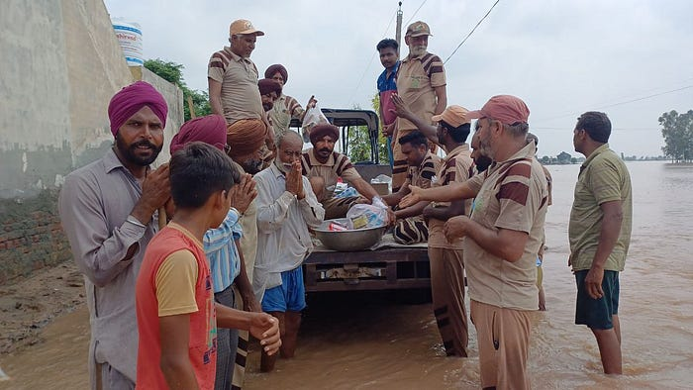
Green S Force is actively providing help to the flood-affected people

Slide 6
In such a delicate situation, as in previous years, the Shah Satnam Ji Green S Welfare Force Wing team has descended upon flood-affected areas in Haryana and Punjab.

Slide 7
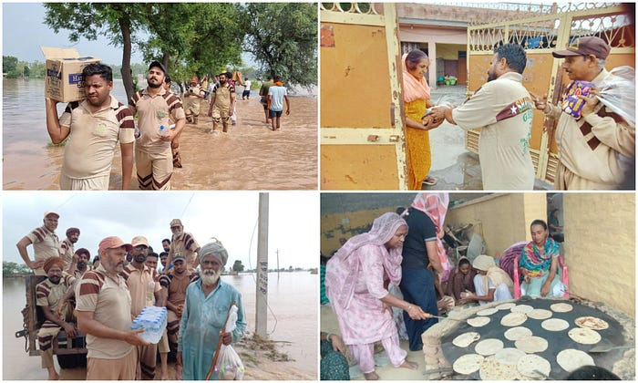
Shah Satnam Ji Green S Welfare Force Wing team

Slide 8
The Green S Force is actively providing help to the flood-affected people in significant numbers in the towns of Patara, Samana, Jakhal, and Fatehabad in Punjab.
Primary challenge in all the flood-affected areas is to deal with the major issue of food and drinking water.
Green S Force is addressing by arranging langars (community kitchens) for them.

Slide 9
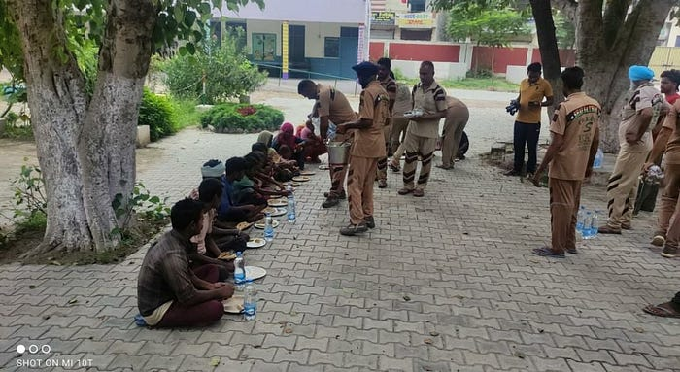
Green S Force soldiers are actively helping the affected people

Slide 10
The images clearly show that wherever you look, there is water everywhere, ranging from four to six feet deep.
The areas of Gulahar, Khetipur, and Joge in the Patta region are filled with enthusiasm as the Green S Force soldiers are actively helping the affected people by traveling in boats and providing all kinds of assistance.

Slide 11
When the District Administration sought the help of the Green Welfare Force Wing to save the lives of the people trapped later, and as soon as the call from the Dera management reached the mobile phones of these sewadars (volunteers), they immediately left their work, business, and families behind to serve humanity.

Slide 12
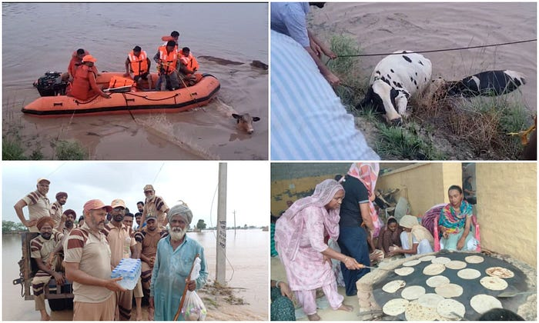

Slide 13
I must tell you that whenever a natural disaster strikes, it is the soldiers of the Green S Force who are at the forefront. These sewadars began their work with divine chants and humble prayers.

Slide 14
We will continue to provide you with updates as we receive them. I assure you that we will keep you informed about the current situation of the floods and potential flood-prone areas.

Slide 15
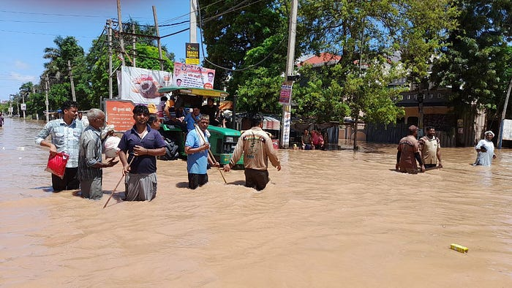
They Are Warriors Who, Without Any Financial Gain, Are Selflessly Fulfilling The Duty Of Humanity

Slide 16
Please let us know how you perceive the work being carried out by these sewadars because they are warriors who, without any financial gain, are selflessly fulfilling the duty of humanity by collecting relief supplies from their own pockets.

Slide 17
ContactUs : TheFactEye
Website :- https://thefacteye.com/
Facebook:- https://www.facebook.com/thefacteye.7
Youtube:- https://www.youtube.com/TheFactEye7
Twitter:- https://twitter.com/TheFactEye
Instagram:- https://www.instagram.com/thefacteye
Pinterest:- https://www.pinterest.co/thefacteye/

